Slide 1
Pitch Deck
Aleksandr Artemov

Slide 2
Agenda
Problem/Hypothesis
Solution
Timeline/Traction
Market
MVP/Product
Business Model
Team

Slide 3
Agenda
Problem/Hypothesis
Solution
Timeline/Traction
Market
MVP/Product
Business Model
Team

Slide 4
Problem/Hypothesis
Current Situation
Medium and small sport leagues (handball) struggling to collect full game statistics due to old-fashioned applications and furthermore coaches can’t better to prepare for their rivals
Pain Points
Data Deficiency: Lack of data and statistics for sport leagues
Old Fashioned Applcations: Applications are using old frameworks

Slide 5
Agenda
Problem/Hypothesis
Solution
Timeline/Traction
Market
MVP/Product
Business Model
Team

Slide 6
Solution
Our product
We offer an intuitive, affordable software for collecting full sport statistics, which in future could be used by coaches and teams
Key features
Full Statistics Coverage: Collect full statistics of games
User-Friendly interface: Easy to navigate and adding new features for comfort of scouts
Comprehensive Support: Includes better tutorials and customer support to help users get started quickly.
AI: ??? Full Analysis for coaches??

Slide 7
Agenda
Problem/Hypothesis
Solution
Timeline
Market
MVP/Product
Business Model
Team

Slide 8
Timeline (1/2)
Test 1st season for one sub Ligue of division
Expand for all divisions in sub Ligue
Discussion with clients
January 2025
May 2025
March 2026
March 2025
September 2025
September 2026
Start of Development of Coach App
Start
Development process
Finish 1st season
Development process
Feature implementation
Review by team
Collecting feedback from client
Suggestions for new feature

Slide 9
Timeline (2/2)
Expand for all handball leagues in Germany
Expand for all handball leagues in BW
Development of App for other Sports
March 2027
March 2028
March 2029
September 2027
September 2028
September 2029
Test 1st season for one sub Ligue of division of Coach App
Expand Coach App among German leagues
Finish 2nd season
Finish 3rd season
Finish 4st season
Development process
Feature implementation
Review by team
Collecting feedback from client
Suggestions for new feature

Slide 10
Agenda
Problem/Hypothesis
Solution
Timeline/Traction
Market
MVP/Product
Business Model
Team

Slide 11
Market (1/2) – Scout market (B2B)
Price Formula for one game
$$price=S+T+A+Sup+M=75\$$$
$$price=S\left(scout\right)=25\$, T\left(training\right)=5\$, A \left(application service\right)=5\$, Sup \left(support\right)=20\$, M \left(Comission\right)=20\$$$
Market for BW Handball leagues (4-7)
Also there are more leagues below 7 and there are more games but for now I took only those divisions which I found
League | # of divisions | # of teams in div | Games per div | Amount in Euro
Regional Ligue | 1 | 16 | 240 | 18000$
Oberliga | 2 | 14 | 364 | 27300$
Verbandsliga | 4 | 14 | 728 | 54600$
Landesliga | 8 | 12 | 1056 | 79200$
All Legues BW Sum |  |  |  | 179100$
All Country divs Sum(10) |  |  |  | 1791000$
Different Sports (4) |  |  |  | 7164000$

Slide 12
Market (2/2) – Coach App Market (B2C)
App costs 10 euro per month for one coach
League | # of divisions | # of teams in div | Amount in Euro/per month
Regional Ligue | 1 | 16 | 160$
Oberliga | 2 | 14 | 280$
Verbandsliga | 4 | 14 | 560$
Landesliga | 8 | 12 | 960$
All Legues BW Sum |  |  | 1960$
All Country divs Sum(10) |  |  | 19600$
Different Sports (4) |  |  | 78400$

Slide 13
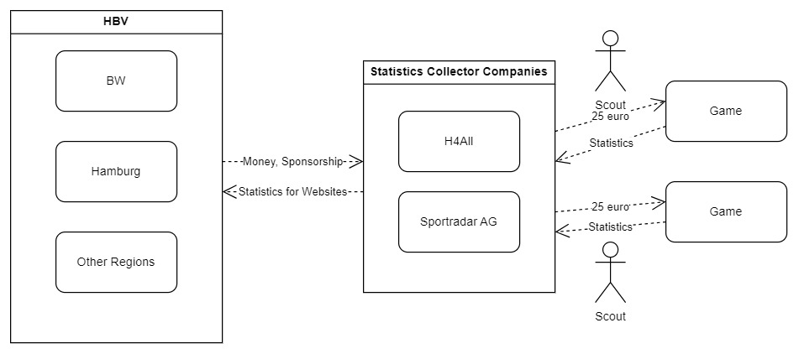
Structure German Handball Divisions

Slide 14
Agenda
Problem/Hypothesis
Solution
Timeline/Traction
Market
MVP/Product
Business Model
Team

Slide 15
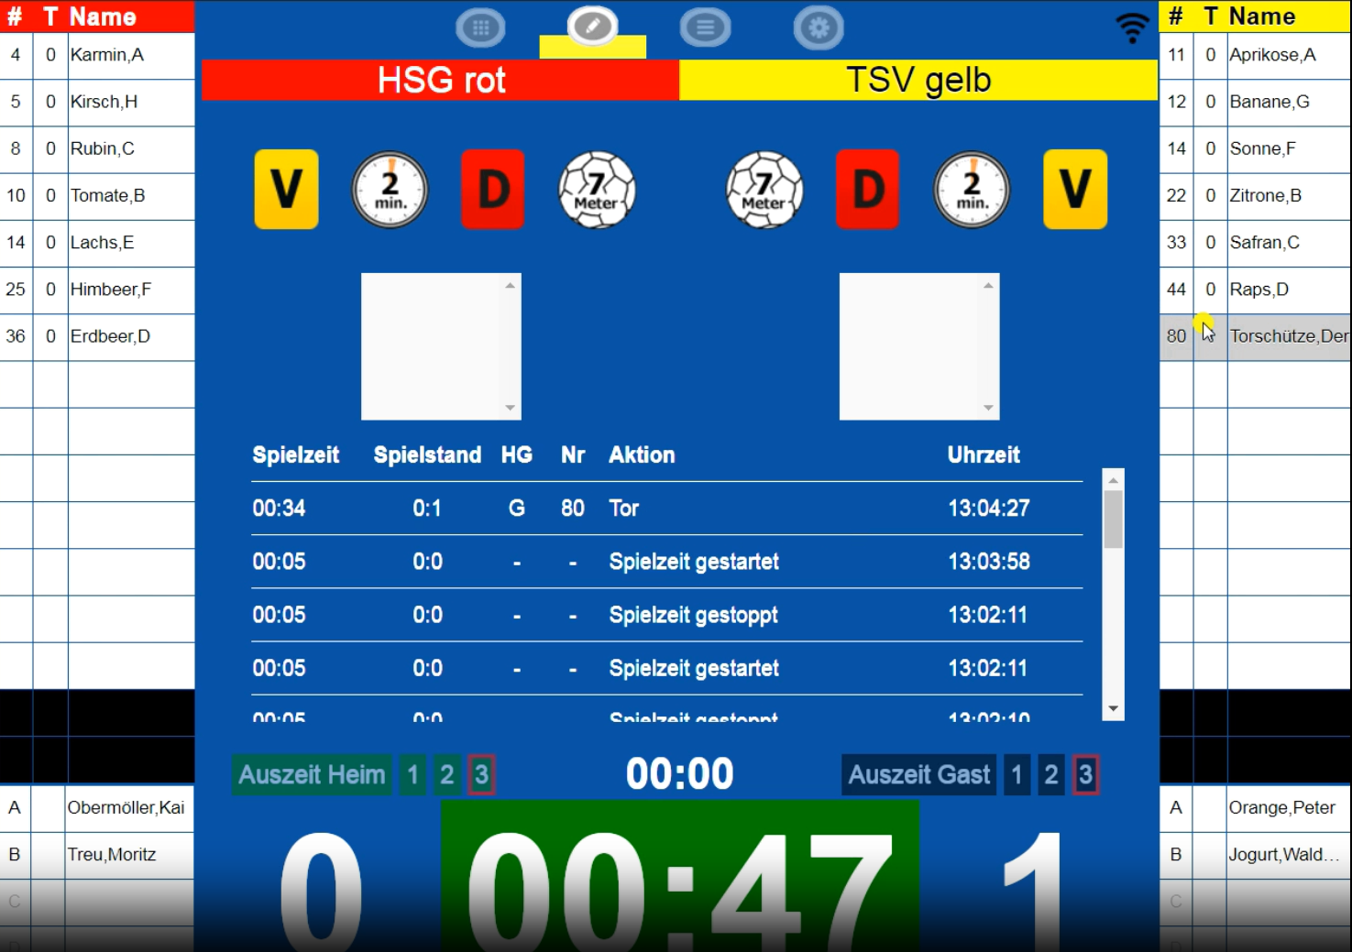
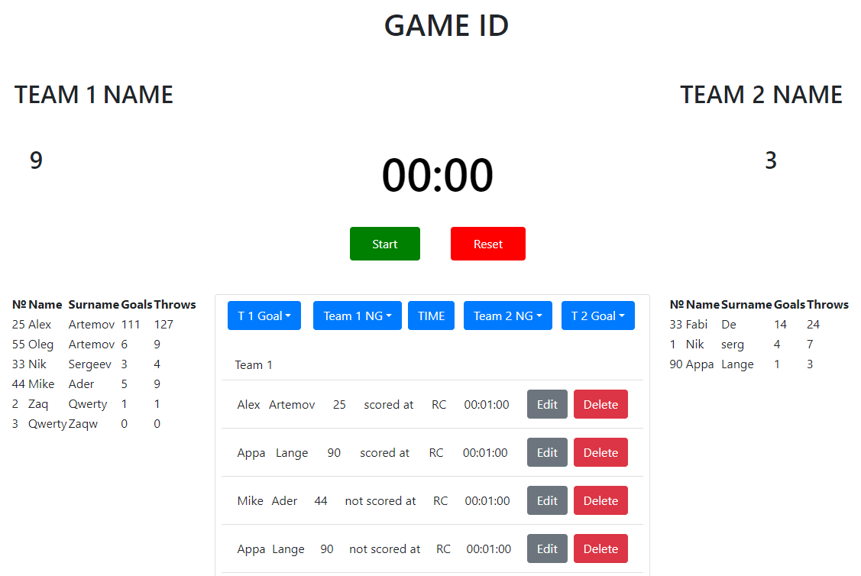
MVP/Product (1/2)
Before
After

Slide 16
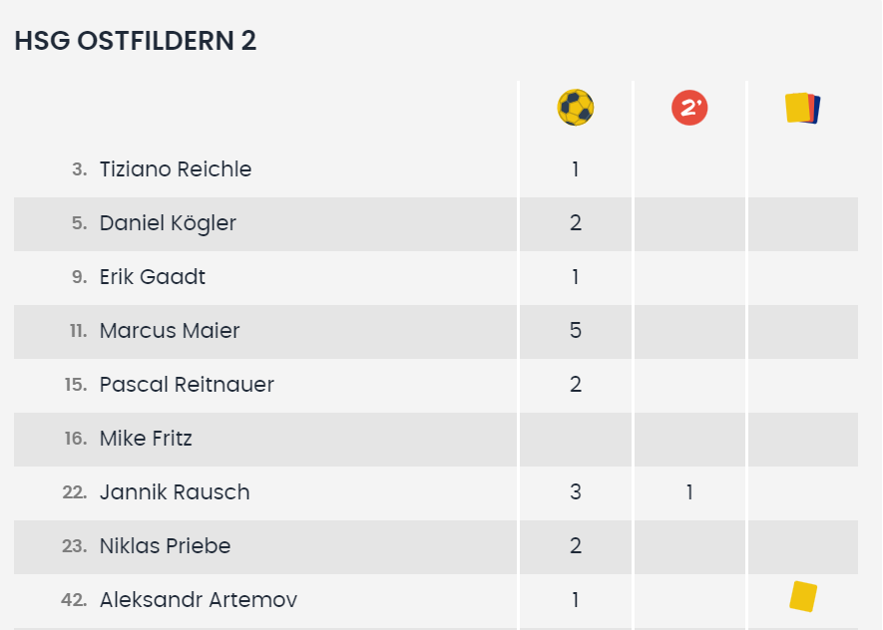
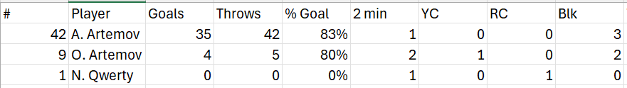
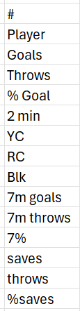
MVP/Product (2/2)
Before
After
New values

Slide 17
Agenda
Problem/Hypothesis
Solution
Timeline/Traction
Market
MVP/Product
Business Model
Team

Slide 18
Business Model
5 YEAR SALES SUMMARY | YR1 | YR2 | YR3 | YR4 | YR5
Total Sales | $13,650 (1 div) | $79,200 (8 div) | $179,100 (BW) | $358,200 (2 lig) | $1,790,000 (all)
Average % Commission | 10% | 15% | 20% | 20% | 25%
Commission Profit | $1,365 | $11,880 | $35,820 | $71,040 | $447,500
Coach Application Subscription/year | - | - | $1,680 (1 div) | $23,520 (BW) | $235,200 (all)
NET PROFIT | $1,365 | $11,880 | $37,600 | $94,560 | $682.700

Slide 19
Agenda
Problem/Hypothesis
Solution
Timeline/Traction
Market
MVP/Product
Business Model
Team

Slide 20
Team
Aleksandr Artemov
Needs: Sales, Communication, Business person

Slide 21
Thank you!
Email: alexartemov21@gmail.com
Tel: +4917684663707

